Slide 1
End Panel 1 (fan side)
Cut 115.6mm (4.5”) ⌀ inner circle
Drill 4.0-4.3mm ⌀ outer holes
(11/64”)
Bumper cut outs x4

Slide 2
End Panel 2 (exhaust side)
Cut 115.6mm (4.5”) ⌀ inner circle
Drill 4.0-4.3mm ⌀ outer holes
(11/64”)

Slide 3
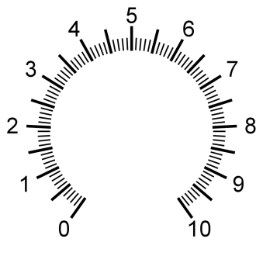
Fan Speed
Right side (Arduino, alarm)
Drill 3-3.2mm ⌀ holes
(1/8”)
7mm (9/32”) for SCR pot
2.4mm (3/32”) for SCR key
Fan side

Slide 4

Left side (power supply)
Drill 3-3.2mm ⌀ holes
(1/8”)
Fan side

Slide 5
6mm
15/64
6mm
15/64
6mm
15/64
8.2mm
21/64”
Digital I/O 1
8.2mm
21/64”
Analog Input 1 (diode)
8.2mm
21/64”
Digital I/O 2
8.2mm
21/64”
Analog Input 2
8.2mm
21/64”
Current Sense
15mm
5/8”
USB
Back side (I/O connections)
6mm (15/64”) for mono
6mm (15/64”) for Relay bolts
8mm (5/16”) for DC
8.2mm (21/64”) for BNC
14.3mm (9/16”) for AC
15mm (5/8”) for USB
8.2mm
21/64”
External Analog Input
375 nm
8mm
5/16”
420 nm
530 nm
8.2mm
21/64”
On-Board Output (Do not load)
6mm
15/64
External Thermistor
LED Output
14.3mm
9/16”
Fan side

Slide 6
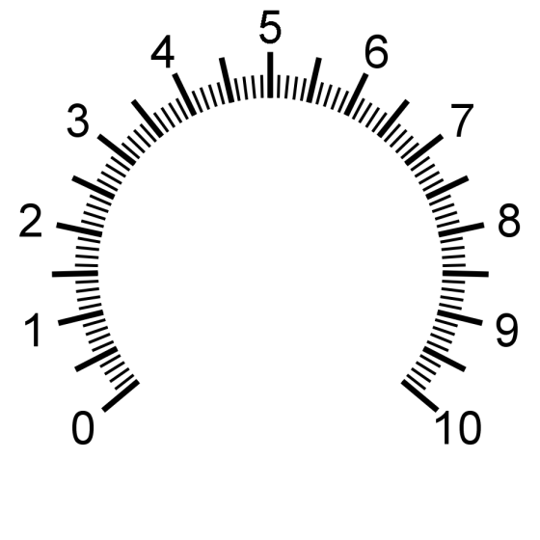

Auto
Manual
Front side (Controls)
**Drill keys first
7.2mm (9/32”) for pot
3.2mm (1/8”) for pot key
9.8mm(25/64”) SP4T
3.2mm(1/8”) SP4T key
20mm(13/16”) AC switch
2.4mm (3/32”) AC key
5mm (13/64”) LED
6.4mm (1/4”) Toggle
2.2mm (3/32”) Toggle key
Overheat
Warning
LED Intensity
420 nm
Power
375 nm
530 nm
Fan
Off
LED Selector

